Slide 1
Guidelines for Individualized Academic Curriculum and ITS Implementation for K-12 Students: a Resource Guide
Intelligent tutoring systems
ITS search tool
Search Criterion: -- Subject(s)/Domain -- -- Grade Range -- -- Tutor/Instruction Type --
Math
ELA
Science
History
English
Pre-K
Elementary
Middle
High
Core Curriculum
Complementary
Catch-Up
 | School | Subject | Grade | Link | Add to
1 | Carnegie Learning | Math (Algebra) | Grade: 9 | https://www.carnegielearning.com/solutions/math
2 | School 2 | ELA | Grade: 7 | https://school2/this/link/will/not/work
3 | School 3 | ELA | Grade: 7 | https://school3/this/link/will/not/work
4 | IXL | Science (Chemistry) | Grade: 12 | https://www.ixl.com/science
5 | IXL | Social Studies | Grade: 2 | https://www.ixl.com/social-studies
6 | School 8 | Social Studies | Grade: 5 | https://school8/this/link/will/not/work
ITS Implementation Resource Page
< 1 2 3 4 >
CS6460: GPACII-K12 – Wireframe Prototype

Slide 2
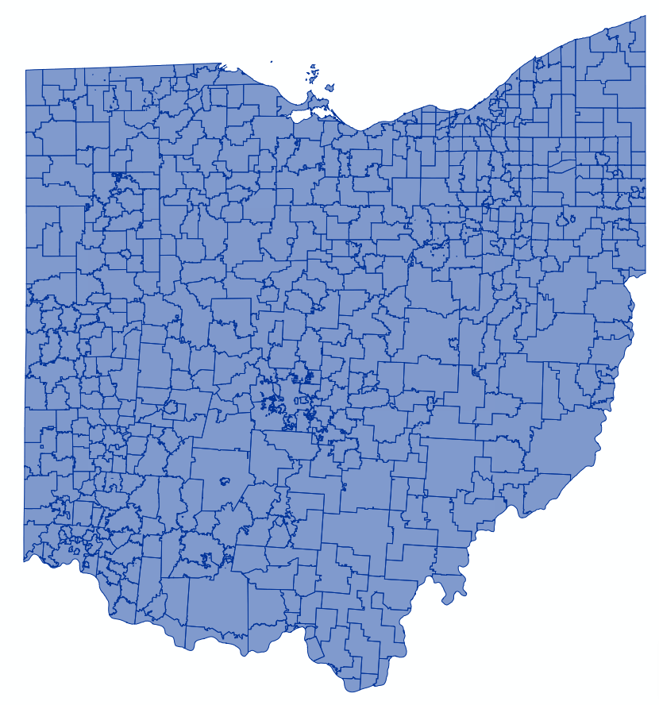
CSE 6242 Team #73: US School District Map Wireframe Prototype C
Comparison: by Time by State by County by City by District
Color by
Graduation Rate
Median SAT Scores
Median ACT Scores
College Matriculation Rate
--Select--
--Select--
New Mexico
Nevada
New York
Ohio
Oklahoma
Oregon
Pennsylvania
Rhode Island
South Carolina
New Mexico
Nevada
New York
Ohio
Oklahoma
Oregon
Pennsylvania
Rhode Island
South Carolina
--Data Set Select--
90-100
80-90
70-80
60-70
50-60
40-50
30-40
20-30
10-20
0-10
90-100
80-90
70-80
60-70
50-60
40-50
30-40
20-30
10-20
0-10
Time Range 1:
2010-2015
Time Range 2:
2015-2020
Time Interval: 10 Year 5 Year 2 Year
Time Interval: 10 Year 5 Year 2 Year

